Slide 1

Multi-Cloud, Security and DevSecOps Presentation
Tom Fisher
May, 2018
Notes:
To change the image on this slide, select the picture and delete it. Then click the Pictures icon in the placeholder to insert your own image.

Slide 2

What Keeps This Guy Awake at Night?

Slide 3

Multi-Cloud Concerns
Different Management Interfaces for each Cloud environment
Application Sprawl
Especially with Container technology
Migration
Compliance
HIPAA, PCI DSS, FISMA, SOX, etc.
Security
Especially between different cloud environments
Cost Control
Forecasting AWS, Azure, Google and etc. costs to right-size cloud expenses and choose the proper platforms on which to deploy

Slide 4

Multi-Cloud Security Concerns
Type of threats that can imperil cloud environments
Data breaches and loss
Distributed Denial of service (DDoS)
Insufficient identity and access management
Insecure interfaces and application programming interfaces (APIs)
System vulnerabilities
Account hijacking
Abuse and nefarious use of cloud services
Malicious insiders
Advanced persistent threats
Shared technology vulnerabilities

Slide 5
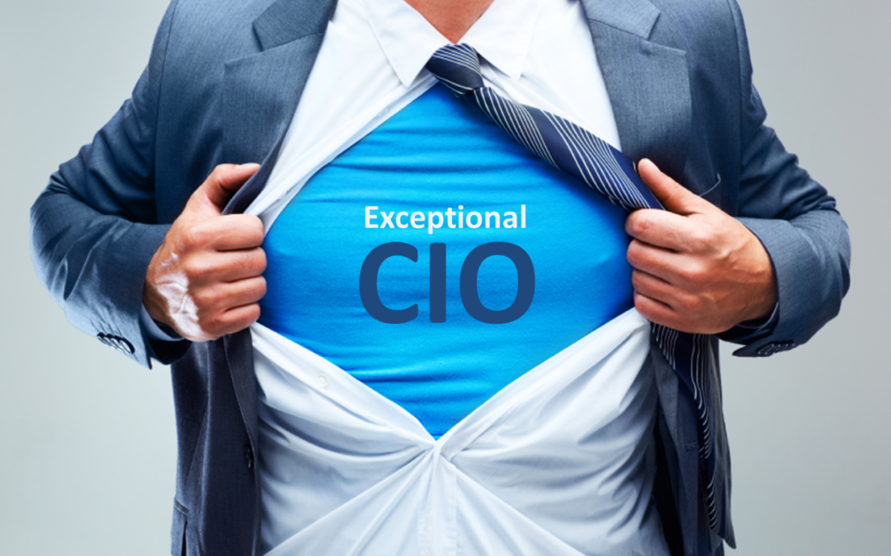
CIO
Responsibilities
Creating a reliable IT infrastructure that supports the business and enables business agility
Managing the IT infrastructure, including budgeting and allocation of technological and human resources
Concerns
Security
Is anything bad happening to corporate data – theft, illegal access, etc.
Multi-Cloud
Maintaining business agility while moving infrastructure to multi-cloud environments
Ensuring that the businesses critical apps are 100% available during the move

Slide 6
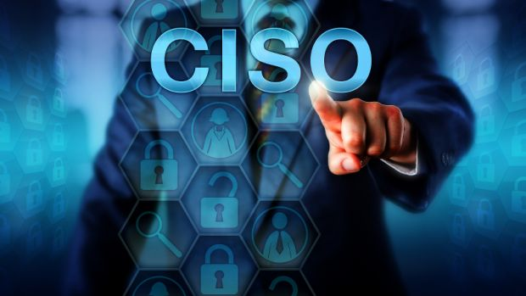
CISO
Responsibilities
Develop a cybersecurity strategy that protects customer data against all threats
Deliver clear security reports at board meetings
Advocate for technology that improves cyber defenses
Respond to cybersecurity threats
Challenges
Staying up-to-date with local and global security challenges, new technologies and compliance issues
Delivering strategy and response reports to non-technical board and business leaders

Slide 7
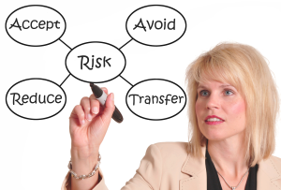
Director of Security or Risk Manager
Responsibilities
Contribute to IT quality and process improvement
Perform Application, Infrastructure & Network security risk management
Develop IT security and risk management frameworks and policies
Translate policy statements to enforceable actions
Perform validation of all security measures
Challenges
Difficulty in measuring the performance of their programs
Difficulty assessing the risks they need to protect against

Slide 8

Director of DevSecOps
Responsibilities
Release new software rapidly by closely aligning development, testing, and operations for faster product delivery
Ensures application and data security across all cloud tiers
Concerns
Needs visibility into all security risks across all cloud environments so that they can be addressed
New tools emerging all the time to make keeping developer skills up-to-date difficult
Wants to see examples of how other development teams have used technology

Slide 9

DevSecOps Engineers
Responsibilities
Participates in strategic project-planning
Responsible for developing and building applications including security
Build automated deployments using CI/CD
Create maintenance requirements and procedures
Troubleshoots existing and resolves existing errors
Recommends ways to improve application performance
Concerns
Needs visibility into all security risks across all cloud environments so that they can be addressed
Needs solid DevOps automation tools
Wants to see examples of how other engineers have used technology

Slide 10
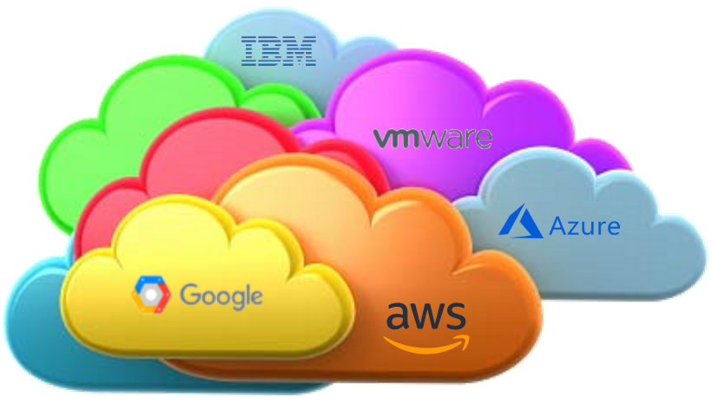
Conclusions
Multi-cloud implementations are being done around the globe in real time
Intra- and Inter-cloud security is rapidly becoming the number one multi-cloud deployment issue
Application Container technology adding fuel to the fire

